Slide 1
Lesson objective
Title: Rates and ratios
Aim:
Be able to create equivalent ratios
Simplify ratios
Calculate rates
Plan:
Ratio revision
Review index laws
Explore rates

Slide 2
Daily review
45 seconds, tell the person next to you how many…
Seconds in 4 minutes?
Seconds in 1 hour?
What is the time elapsed between 11am – 2:25pm?
Meters travelled after going 50km/h for 3.5 hours?

Slide 3

Re-teach
INDEX NUMBER
$$8^{4}$$
BASE NUMBER

Slide 4

Retrieve
Identify the base and index number:
$7^{3}$
${12}^{6}$
$1^{10}$

Slide 5
Choral response
When multiplying indices with the same base, add index numbers.
When dividing indices with the same base, subtract index numbers.

Slide 6
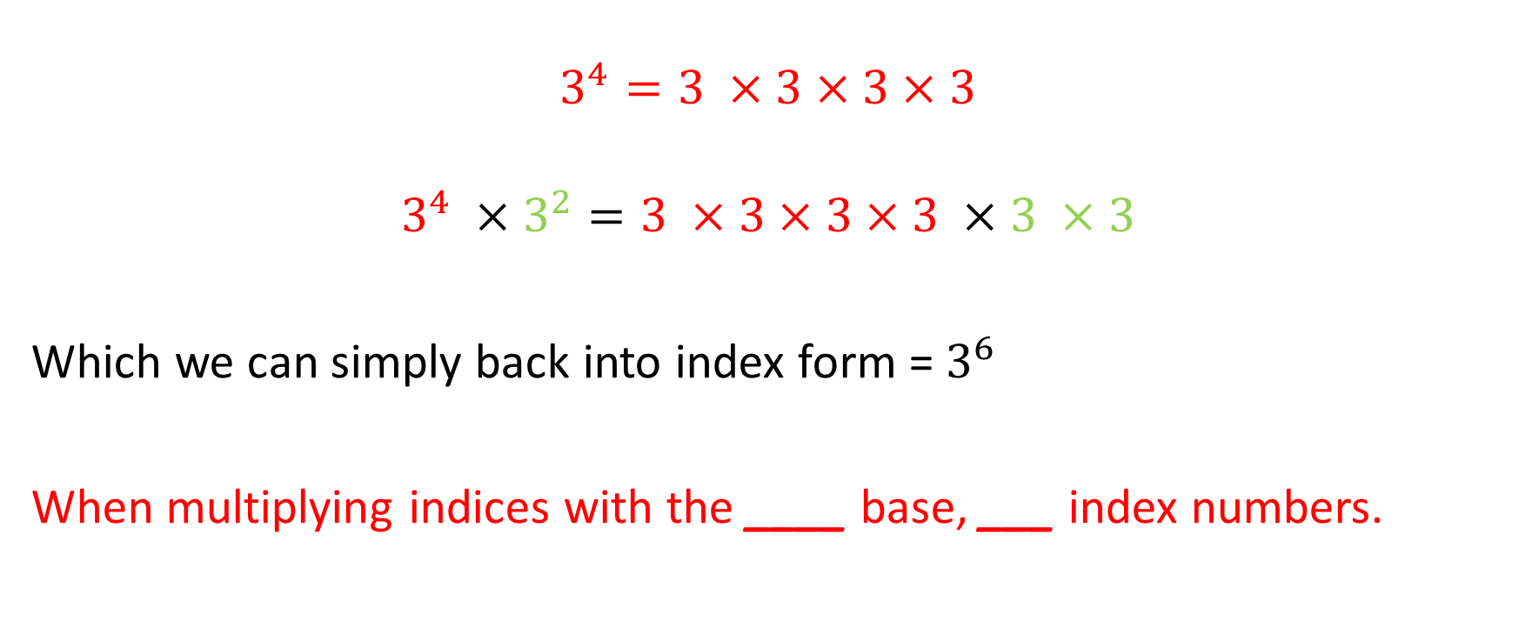
Visual
INDEX FORM
EXPANDED FORM
$$3^{4}=3 ×3×3×3$$
$$3^{4} ×3^{2}=3 ×3×3×3 ×3 ×3$$
Which we can simply back into index form = $3^{6}$
When multiplying indices with the ____ base, ___ index numbers.

Slide 7
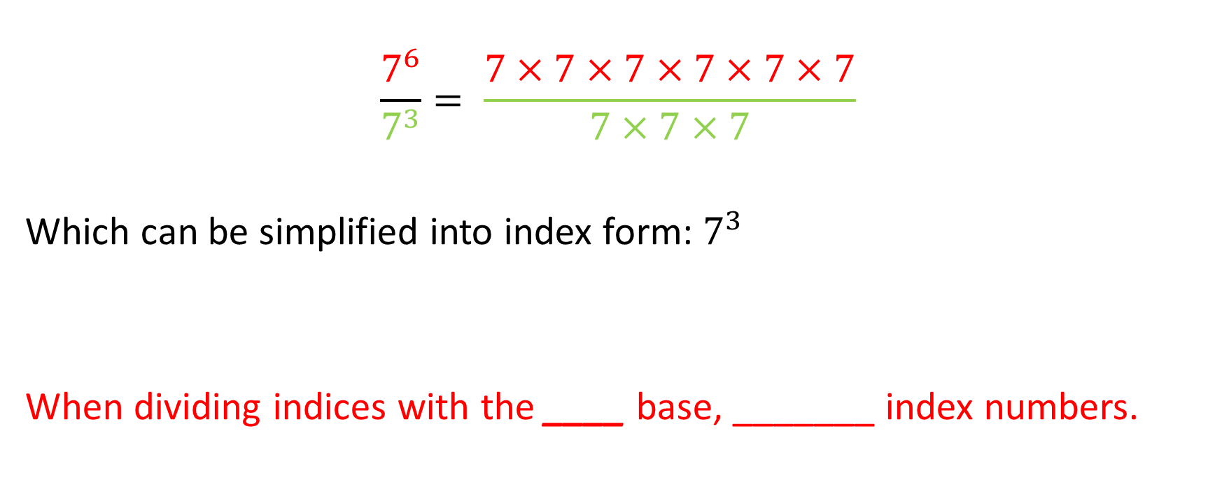
Visual
INDEX FORM
EXPANDED FORM
$$\frac{7^{6}}{7^{3}}= \frac{7×7×7×7×7×7}{7×7×7}$$
Which can be simplified into index form: $7^{3}$
When dividing indices with the ____ base, _______ index numbers.

Slide 8


Retrieve
INDEX FORM
EXPANDED FORM
$$3^{4}=3 ×3×3×3$$
INDEX NUMBER
$$8^{4}$$
When multiplying indices with the ____ base, ___ index numbers.
When dividing indices with the ____ base, _______ index numbers.
BASE NUMBER

Slide 9


Apply: simplify in exercise books
Adding indices
Subtracting indices
$9^{3} × 9^{5}$
$7^{5} ×7^{4}$
$5^{2} × 5^{6}$
$9^{7} ÷ 9^{5}$
$\frac{{11}^{9}}{{11}^{6}}$
${21}^{9} ÷ {21}^{8}$

Slide 10
Ratios
Visual Example 1:
Ben the painter needs 6 litres of dark purple, he uses 4 litres of red paint and 2 litres of blue paint.
Write the ratio of the number of red tins to the number of blue tins in its simplest form.
Red : Blue
4 : 2
÷2
÷2
:
2
1

Slide 11
Ratios
Visual Example 2:
Sarah has a number of white and black counters in a bag..
Write the ratio of the number of black counters to the number of white counters in its simplest form.
Black : White
3 : 9
÷3
÷3
:
1
3

Slide 12
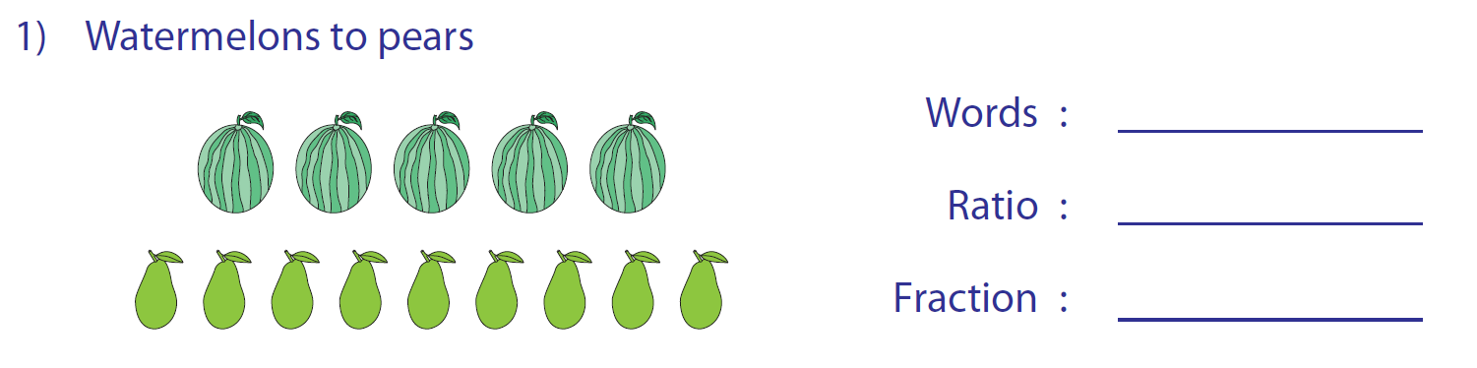
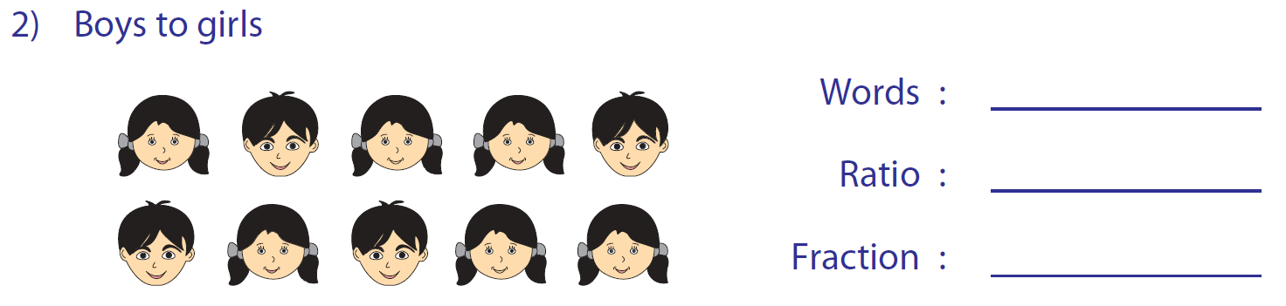


Ratios compare the number of different things
Watermelons : Pears
5 : 9
$$\frac{5}{14}:\frac{9}{14}$$
4 : 6
Always simplify if possible
Boys : Girls
2 : 3
$$\frac{2}{5}:\frac{3}{5}$$

Slide 13
Ratios
Examples:
I do
Find the missing number
12 : 7
x 3
x 3
36 : ?
21
We do
The ratio of men to women in a sports club is 7 : 11
There are 175 men. How many women are there?
men : women
7 : 11
x25
x25
175 : ?
275
There are 275 in the club
You do
A map has a scale of 1 : 20000
What distance does 8km on the map represent in map?
Map : Real Life
1 : 20000
x40
x40
40cm
? : 800000cm
On the map it is 40cm

Slide 14

Ratios
Exercise Two:
1
Find the missing numbers in the ratios
a
3 : 2
9 : ?
b
7 : 12
? : 96
c
15 : 11
60 : ?
d
13 : 14
? : 84
e
3 : 5 : 7
? : 45 : ?
6
56
44
78
27
63
2
The ratio of men to women in a golf club is 8 : 5
There are 64 men in the club. How many women are there?
40 women
3
In a school the ratio of teachers to students is 2 : 35.
There are 1120 students. How many teachers are in the school?
64 teachers
4
Part of a cake is made of sugar and butter in the ratio 2:3. How many grams of sugar do you need when you have 150g of butter?
100g of sugar
5
Lucy, Adam and Alex share money in the ratio 3 : 2 : 5.
If Adam gets $48. How much does Lucy and Alex get?
Lucy $72
Alex $120
6
A map has a scale of 1 : 10000.
What is the real distance if the measurement on the map is 6cm?
0.6 km
7
A map has a scale of 1 : 20000.
What is the map measurement if the real distance is 5km?
25cm

Slide 15
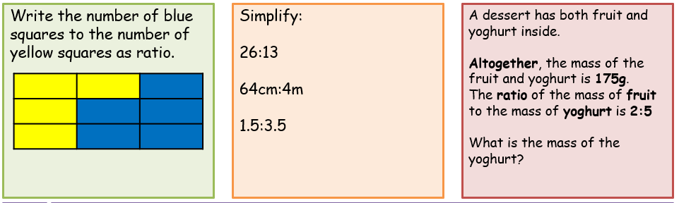
Easy Medium Hard

Slide 16
Rates
Rates are a measure of how one quantity changes for every unit of another quantity.
Rates are a _________ of how one quantity changes for every unit of another quantity.
Rates are a _________ of how one quantity changes for every ____ of another quantity.

Slide 17
Rates
Big Bass Dam needs 100 000L to fill it up. If the hose pumps in water at 250L per minute, how long until it fills up?
Sally burns 430Kj an hour when running. If she runs for 3.5 hours, how many Kjs will she burn?

Slide 18
Speed, distance, time pyramid
Speed x Time = Distance
Distance ÷ Time = Speed
Distance ÷ Speed = Time
DISTANCE
SPEED
TIME

Slide 19
Complete rates Questions
Complete “That’s fast” question set

